Slide 1


Introduction to MATLAB
Calcoli di Processo dell’ Ingegneria Chimica
Lorenzo Giardini
Department of Chemistry, Materials and Chemical Enginering, “Giulio Natta”, Politecnico di Milano.
email: lorenzo.giardini@polimi.it

Slide 2
Contacts & Information
Professor: Marco Mehl
e-mail: marco.mehl@polimi.it
Office: Leonardo Campus, Building 6, Department of Chemistry, Materials and Chemical Enginering, “Giulio Natta”, Politecnico di Milano.
Teacher assistant: Lorenzo Giardini
e-mail: lorenzo.giardini@polimi.it
Office: Leonardo Campus, Building 6, Department of Chemistry, Materials and Chemical Enginering, “Giulio Natta”, Politecnico di Milano.
2

Slide 3
Resources
Books:
G., Buzzi Ferraris; Manenti, Flavio. Fundamentals and Linear Algebra for the Chemical Engineer: Solving Numerical Problems.
G., Buzzi Ferraris; Manenti, Flavio. Interpolation and Regression Models for the Chemical Engineer: Solving Numerical Problems.
G., Buzzi Ferraris; Manenti, Flavio. Nonlinear Systems and Optimization for the Chemical Engineer: Solving Numerical Problems.
G., Buzzi Ferraris; Manenti, Flavio. Differential and Differential-Algebraic Systems for the Chemical Engineer: Solving Numerical Problems.
J. Nathan Kutz. Data-Driven Modeling and Scientific Computation.
3

Slide 4
Steven L. Brunton; J. Nathan Kutz. Data-Driven Science and Engineering: Machine Learning, Dynamical Systems, and Control.
A. Quarteroni; R. Sacco; F. Saleri; P. Gervasio. Matematica Numerica.
A. Quarteroni; F. Saleri; P. Gervasio. Calcolo Scientifico: Esercizi e problemi risolti con MATLAB e Octave.
D. Manca. Calcolo numerico applicato.
Online Material:
Numerical Methods applied to chemical engineering (MIT).
GitHub repository of the practical sessions.
Matlab online tutorial and documentation.
4

Slide 5
Table of Contents
Introduction
What is programming? The Natural Language of Computers
First Steps with MATLAB Variables
Arrays and Matrices While
Conditional statements If, else if, else
Functions
Exercises

Slide 6
What is programming?
The most simple answer is: “Programming is the act or activity of writing computer programs”. In a more general way programming or coding is the act of writing a computer program.
6

Slide 7
What is programming?
The most simple answer is: “Programming is the act or activity of writing computer programs”. In a more general way programming or coding is the act of writing a computer program.
A computer program is a sequence of instructions that a computer is able to execute.
6

Slide 8
What is programming?
The most simple answer is: “Programming is the act or activity of writing computer programs”. In a more general way programming or coding is the act of writing a computer program.
A computer program is a sequence of instructions that a computer is able to execute.
Computer in the definition above is any device that is capable of processing code. This could be smartphones, ATMs, the Raspberry Pi, Servers to name a few.
6

Slide 9
What is programming?
The most simple answer is: “Programming is the act or activity of writing computer programs”. In a more general way programming or coding is the act of writing a computer program.
A computer program is a sequence of instructions that a computer is able to execute.
Computer in the definition above is any device that is capable of processing code. This could be smartphones, ATMs, the Raspberry Pi, Servers to name a few.
Remember, every time we use smart devices, some code is running in the background. Moving a mouse pointer from one part of your computer screen to the other may seem like a simple task, but in reality, so many lines of code just ran. An act as simple as typing letters into Google Docs leads to lines of code being executed in the background. It’s all code everywhere.
6

Slide 10
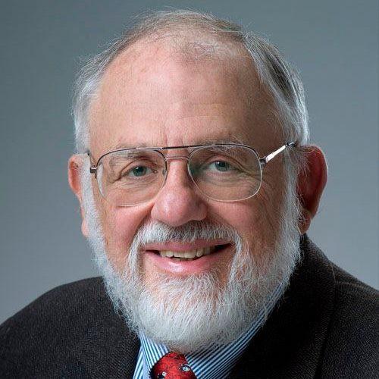
The Natural Language of Computers
The only language understood by a computer is the machine language. A very long list of 0 and 1. However it is a little bit inconvenient to write a series of zeros and ones. So (very smart) people, like the one in the picture, invented what are called programming languages (C/C++, Fortran, Python, Julia, MATLAB, ...).
N.B. Computers aren’t very smart, the instructions need to be very precise! Telling a computer what you want it to do is sometimes hard because you have to explain things very carefully and precisely.
Figure 1: Cleve Barry Moler

Slide 11
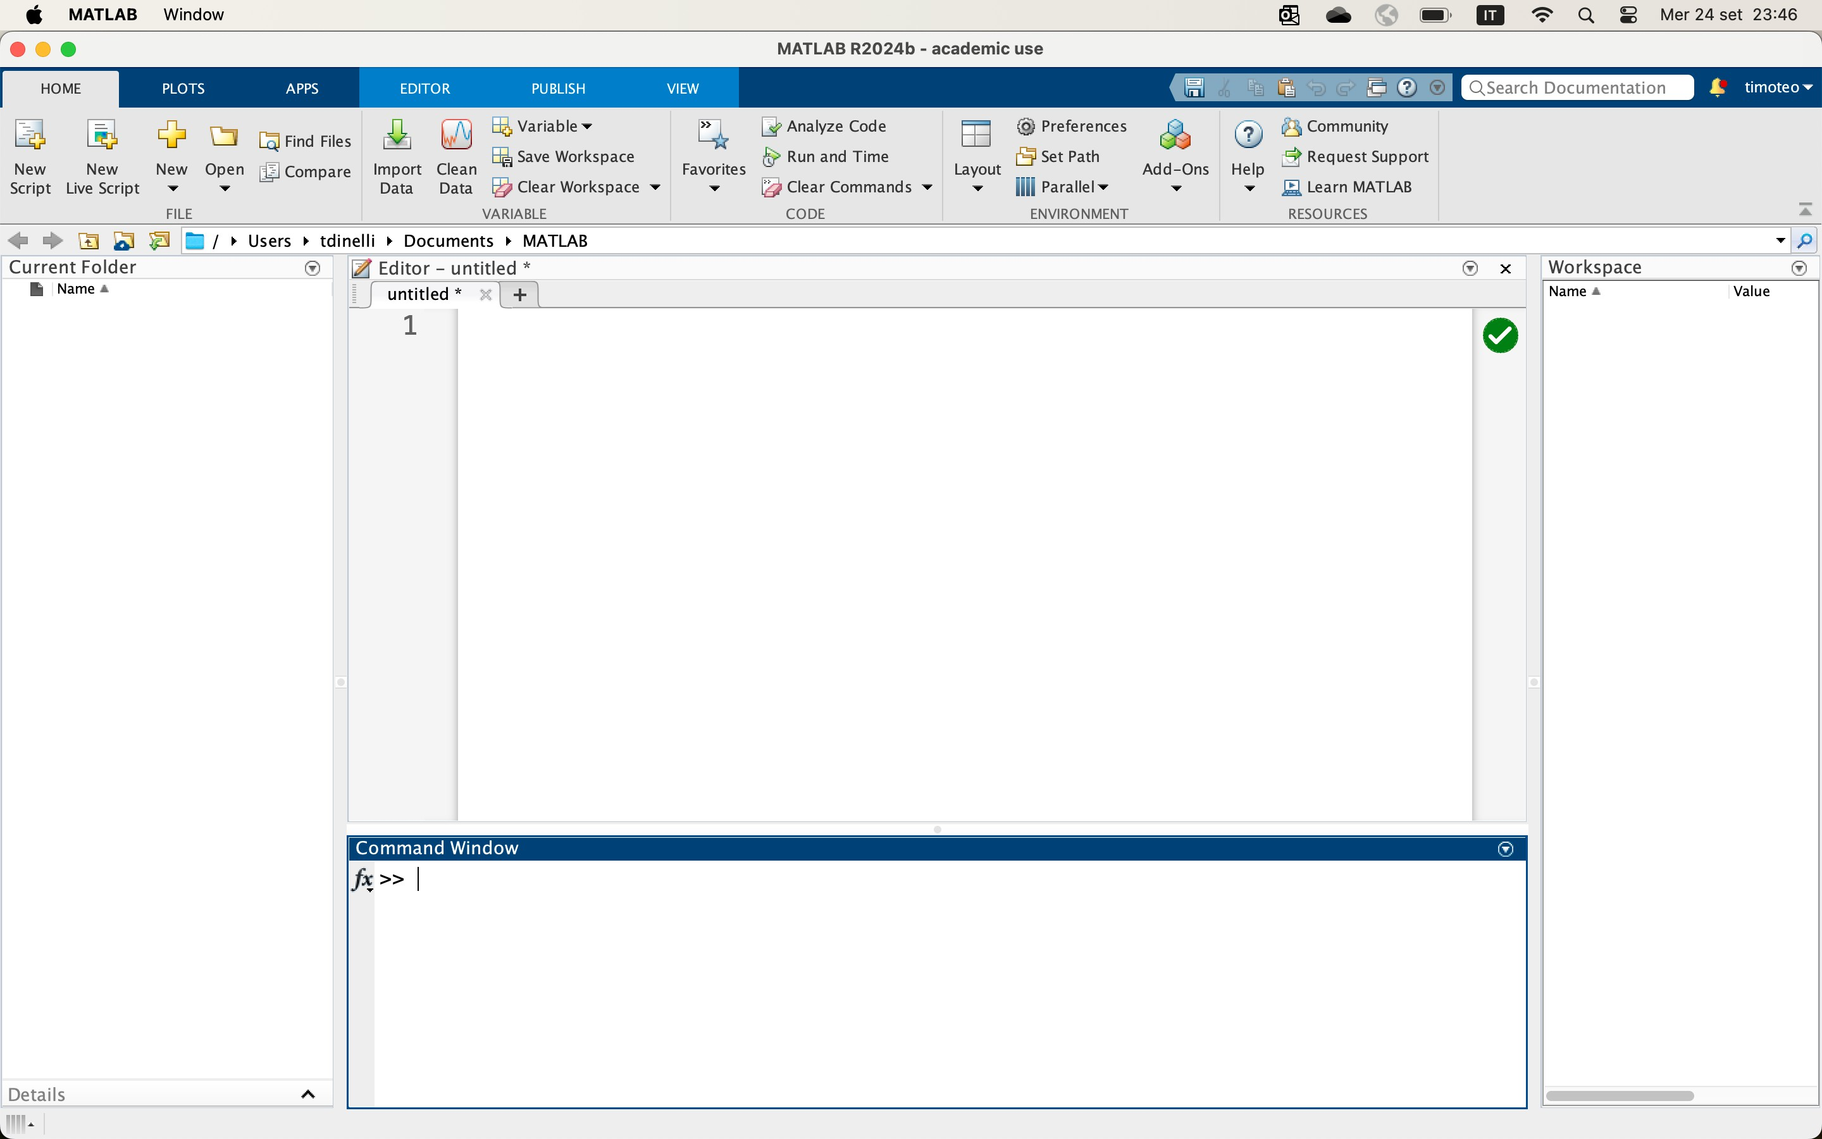
MATLAB
Text editor
Here is where you will find the files
Command Window
(Terminal)
Variables

Slide 12
What can a Computer handle?
MATLAB deals with numbers, arrays of numbers, characters, strings.
9

Slide 13
What can a Computer handle?
MATLAB deals with numbers, arrays of numbers, characters, strings.
Numbers can be of different types: signed and unsigned integers, and single-precision and double-precision floating-point numbers.
9

Slide 14
What can a Computer handle?
MATLAB deals with numbers, arrays of numbers, characters, strings.
Numbers can be of different types: signed and unsigned integers, and single-precision and double-precision floating-point numbers.
When we set (create) a variable, its value is stored as a series of 0 and 1 in a memory slot whose size depends on the type of variable (i.e., single-precision floating point numbers take 32 bits, or 4 bytes of memory, double precision 64 bit, or 8 bytes).
By default, MATLAB store all values as double-precision floating point.
9

Slide 15
Area of a cylinder
Let’s compute the lateral area of a cylinder given the diameter D = 20 cm and height h = 50 cm.
What happens:
Create variable D = 0.2 m
Create variable h = 0.5 m
Calculate perimeter = π × 0.2
Calculate Area = perimeter × 0.5
Code:
1 D = 0.2;
2 h = 0.5;
% m (diameter)
% m (height)
3 perimeter = pi * D;
4 Area = perimeter * h;

Slide 16
Source code: scripts and functions in MATLAB
Scripts are m-files (text format) containing MATLAB statements. MATLAB “functions” are another type of m-file. The biggest difference between scripts and functions is that functions have input and output parameters. Script files can only operate on the variables that are “hard-coded” into their m-file.
1 D = 0.2;
2 h = 0.5;
% m
% m
1 function Area = ComputeArea(D, h)
2
3
4 end
perimeter = pi * D; Area = perimeter * h;
3 perimeter = pi * D;
4 Area = perimeter * h;
ans = 0.3142
ComputeArea(0.2, 0.5)
ans = 0.3142

Slide 17
Variables names
MATLAB is case sensitive! Pippo /= pippo
Variables name should be self explanatory, so prefer distance, radius, ... rather than a, b, ...
When possible, use the camel case notation to make stuff easier to read.
PipeLength, GasTemperature, ....
Alternative (what you prefer!) snake case: pipe_length, gas_temperature, …

Slide 18
Arrays and Matrices
In MATLAB arrays are defined as:
v = [5 13 97 31 98]
v =
5 13 97 31 98
Matrices can be defined as a set of stacked arrays separated with ;
M = [5 13 97; 31 98 36; 11 9 20]
M =
5
31
11
13
98
9
97
36
20

Slide 19
Elements can be accessed using their index (indices in MATLAB starts from 1)
v(1)
ans = 5
M(2,1) % (row number, column number)
ans = 31

Slide 20
Creating arrays and matrices
Create a matrix of zeros or ones:
A = zeros(3,2) |  |  | A = ones(2,3)
A = |  |  | A =
0 | 0 |  | 1 | 1 | 1
0 | 0 |  | 1 | 1 | 1
0 | 0

Slide 21
Create a vector of n equally spaced elements:
v1 = [1:2:11] % Parenthesis can be omitted: v1 = 1:2:11
v1 = 1 3 5 7 9
11
v2 = [1:3:11]
v2 = 1
% Parenthesis can be omitted
4 7 10 % be careful!
v3 = linspace(1,10,6) % Parenthesis can NOT be omitted!
v3 = 1.0 2.8 4.6 6.4 8.2
10.0

Slide 22
Operations with arrays and matrices
Copying a line or a column of a matrix:
Size of a matrix:
M = [1 2 3; 4 5 6]
size(M)
v = M(1,:)
v =
ans = 2 3
Copying a matrix:
1
2
3
Size of an array:
A = M
size(v)
A =
ans = 1 3
1 | 2 | 3
4 | 5 | 6
length(v)
ans = 3

Slide 23
Matrix transposition:
Matrix multiplication:
M * B
Error using * Inner matrices dimensions must agree.
M * C
C = B'
C = | 1 | 4
 | 2 | 5
 | 3 | 6
Element wise multiplication:
ans = 14
32
M .* M
32
77
ans =
1
16
4
25
9
N.B. size(M) = 2 3; size(C) = 3 2
36

Slide 24
Loops and conditional statements

Slide 25
for loop
The for loop repeats a series of instructions a fixed number of times.
1 for i = 1:10 % equivalent to 1:1:10. Spacing is one by default.
2
3 end
paperino(i) = i;
paperino | = | 1
paperino | = | 1 | 2
paperino | = | 1 | 2 | 3
...
paperino | = | 1 | 2 | 3 4 5 6 7 8 9
paperino | = | 1 | 2 | 3 4 5 6 7 8 9 10

Slide 26
The index of the for loop can be changed by an arbitrary increment:
1 for i = 10:-1:1
2
3 end
pluto(i) = i;
pluto | = | 0 | 0 | 0 | 0 | 0 | 0 | 0 | 0 | 0 | 10
pluto | = | 0 | 0 | 0 | 0 | 0 | 0 | 0 | 0 | 9 | 10
pluto | = | 0 | 0 | 0 | 0 | 0 | 0 | 0 | 8 | 9 | 10
...
pluto | = | 0 | 2 | 3 | 4 | 5 | 6 | 7 | 8 | 9 | 10
pluto | = | 1 | 2 | 3 | 4 | 5 | 6 | 7 | 8 | 9 | 10

Slide 27
Examples
Sum the first hundred natural numbers.
^{I:} i =?.
i=1
100
Sum hundred times one.
100
^{I:} 1 =?
i=1
1 sum = 0;
2 for i = 1:100
1 sum = 0;
2 for i = 1:100
3
4 end
sum = sum + i;
3
4 end
sum = sum + 1;
5 disp(sum);
5 disp(sum);

Slide 28
while loop
The while loop repeats a series of instructions as long as a condition is TRUE.
N.B. pay attention with the while loop it can run indefinitely, handle with care.
1 result = 0;
2 token = 0;
3 while (sum < 325)
4
5
6 end
token = token + 1; result = result + token;
7 disp(['Iteration number: ', num2str(token)]);
8 disp(['Sum is equal to: ', num2str(result)]);
Iteration number: 25 Sum is equal to: 325

Slide 29
IF Statement
The IF statement executes a series of instructions only IF a condition is TRUE:
Example: Write a simple script to compute the absolute value of a number.
1 if (condition)
2
% instructions
3 elseif (condition)
4
% instructions
1 x = 35;
2 if (x >= 0)
5 elseif (condition)
6
% instructions
3
abs = x;
7 else
4 else
5
6 end
8
9 end
% instructions
abs = -x;

Slide 30
Functions
In MATLAB, a function is a block of code that takes inputs, performs a set of operations, and returns outputs. Functions allow you to organize code in a clearer and more reusable way, especially when you need to perform the same operation in different parts of your program.
Why using functions?
Modularity: Separating code into functions makes the program more readable and easier to maintain.
Reusability: A function can be reused in different parts of the program without rewriting the code.

Slide 31
Syntax
1 function [y1, ..., yN] = function_name(x1, ..., xM)
2 % ...
3 % ...
4 % ...
5 % Some code
6 % ...
7 % ...
8 % ...
9 end
Input variables.
Name of the function (user defined).
Output variables (parenthesis can be omitted).

Slide 32

The Babylonian method
Let’s write a script implementing the Babylonian method to compute the square root of a number with a precision of four decimal figures, then wrap this code into a function.
1. Make an Initial guess. Guess any positive number x₀.
_{x0+} S
2. Improve the first guess. Apply the formula x₁ =
x₀
₂ . The number x₁ is a
better approximation to $\sqrt{S}$
xn+ ^{S}
3. Iterate until convergence. Apply the formula x_{n+1} = ₂ ^{xn} until the convergence is reached.
Convergence is reached when the digits of x_{n+1} and x_{n} agree to as many decimal places as you desire.

Slide 33
Implementation
1 function SquareRoot = ComputeSquareRoot(S)
2
3
4
5
6
7
8
9
10
11
12
13
iter = 0; x0 = S; % Use S as guess for the problem
y = 0.5 * (x0 + S/x0);
while abs(x0-y) > 1e-4 && iter < 50 x0 = y;
y = 0.5 * (x0 + S/x0); iter = iter + 1;
end
disp(['Number of iteration to reach convergence: ', num2str(iter)]) SquareRoot = y;
14 end

Slide 34
Thank you for the attention!

